Slide 1
Running errands
Basic 10 – Unit 5b

Slide 2
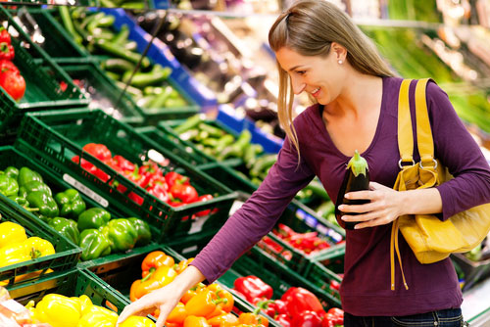
Go Grocery shopping

Slide 3
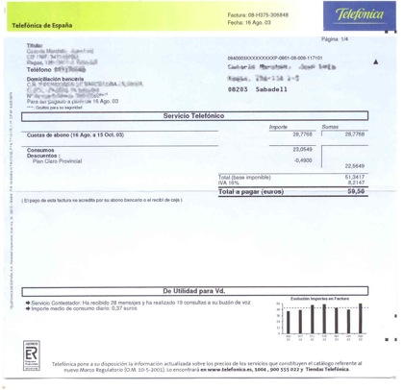
Pay the telephone bill

Slide 4

Take your pet to the vet

Slide 5
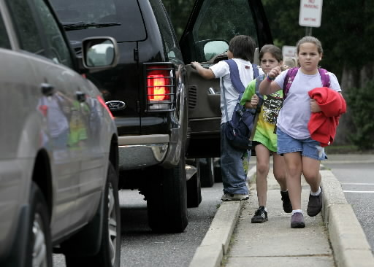
Pick up / get the kids from school

Slide 6
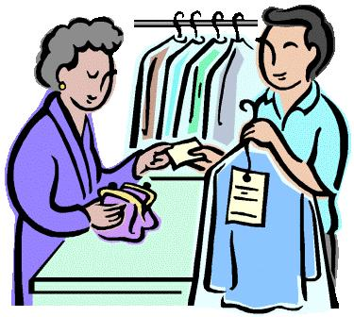
Pick up the dry cleaning

Slide 7
Do the laundry

Slide 8
Iron the laundry

Slide 9
Water the grass

Slide 10
Take out the garbage

Slide 11
Do the dishes

Slide 12
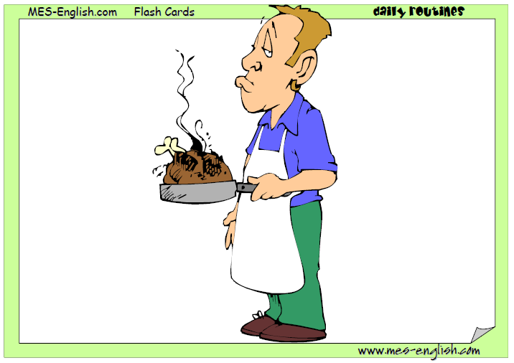
make dinner

Slide 13
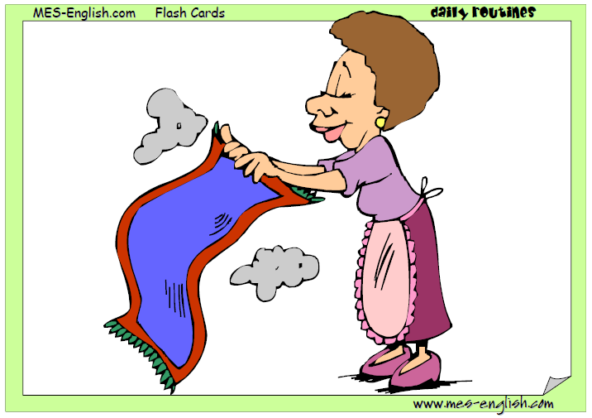
clean the house

Slide 14
Sweep the floor

Slide 15
Vacuum

Slide 16
Mop/wash the floor

Slide 17
Clean the windows

Slide 18
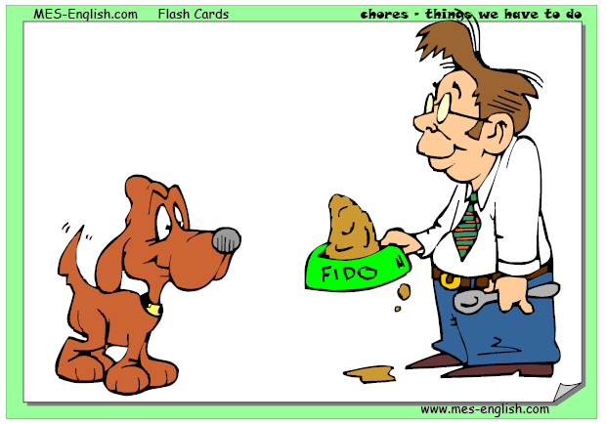
Feed the dog

Slide 19
Wash the dog

Slide 20
listening

Slide 21


Slide 22


